Slide 1
COVID-19 Lab Working Group
Notes:
Colleen Quinn

Slide 2
Topics
COVID-19 Resources from Data Innovations
COVID-19 News & Trends Review
Pooled Specimen Testing Overview
EP Evaluator Use Cases for COVID-19

Slide 3
COVID-19 Resources from Data Innovations
COVID-19 Driver Listing
News Blog
Recurring webinar series
Notes:
<<Standard Challenge Slide>>
And, you’re on the cusp of a major change in how labs are expected to do business. The shift to value-based healthcare demands big change – but delivers bigger opportunity, if you are prepared to address it.

Slide 4
Upcoming Virtual User Groups
Lab Intelligence
September 15th at 10AM PT/1PM ET
Autoverification Rules 101
September 22nd at 10AM PT/1PM ET
High Availability & Disaster Recovery
September 29th at 10AM PT/ 1PM ET

Slide 5
COVID-19 News Summary
Current trending topics
Notes:
Craig Newman

Slide 6
COVID-19 News Current trending topics
Pricing transparency
Lack of COVID-19 testing supplies
Shipping of specimens
https://www.phmsa.dot.gov/sites/phmsa.dot.gov/files/2020-06/UN3373%20COVID%2019%20Safety%20Advisory.pdf
EUAs for pooled COVID-19 testing
Notes:
I wanted to take a few minutes to discuss some of the COVID-19 trends we are seeing to share with our fellow laboratorians.
The first is PRICING TRANSARENCY. There have been a few industry press releases related to COVID-19 pricing for tests performed. Some charges have been intentionally inflated, but many are unintentional and often out of the hands of laboratory leadership such as reimbursement rates from the different payors which have been negotiated. (i.e. insurance providers, Medicare, self pay). As with any test the laboratory performs, be sure to review your charge master to ensure the appropriate test methodology is selected, proper ICD billing codes are associated to that methodology and all of the information is correct across all software systems in the hospital to ensure continuity.
As previously mentioned in an earlier DI COVID webinar, COVID-19 TESTING SUPPLY SHORTAGES are still occurring. This is being experienced across the board from collection supplies, instrumentation and reagents. In an AACC survey of laboratories released within the past two weeks, 50% of the respondents are experiencing shortages in one or more of the categories listed. Be sure to take stock of your inventory both within your lab and suggest an update from your reference lab for those COVID-19 tests being sent out to ensure proper utilization, rationing and proper policies/procedures/protocols are being followed to maintain the highest level of patient quality care.
Whether SHIPPING SPECIMENS to your selected reference lab or if your lab is receiving bulk specimens for outreach or reference lab testing, there are established procedures and protocols for the packing and shipment of biological specimens. As published in the COVID-19 STAT Intelligence briefings from the Dark Daily, in June the DOT issued a Safety Advisory Notice for the transportation of COVID-19 samples on June 19th as recent inspections presented with numerous improperly packaged samples which presents obvious safety and contamination risks at each touch point of the transportation process. This prompted the CDC Division of Laboratory Systems to publish a notice to clinical laboratory professionals regarding proper protocols. The link below is the advisory released by the US DOT. Give your policies, procedures, supplies and internal lab training a review to ensure proper packaging in being followed and ensure the safety of every individual along the transportation process.
Lastly, the ability to meet COVID-19 testing demands continues to grow which has lead to the development of a few tests which can be performed utilizing POOLING of samples. Recently, a few Emergency Use Authorizations (EUAs) have been approved at some large reference laboratories, such as LabCorp and Quest, and some other laboratories like the Cleveland Clinic, Ethos Laboratories, Wren Laboratories and Poplar Health. These tests have only been approved for in-house testing at these laboratories. Due to the growing demand and inquiries for assistance to manage pooling, such as the convolution and deconvolution of pooled samples, DI is actively reviewing the overall solution to determine the use of Instrument Manager and what development efforts may be needed to meet this need.
That said, I will turn this back over to Colleen for our next presentation which will specifically address pooling. Colleen….

Slide 7
Pooled Specimen Testing
Not to be considered a consultation or example of best clinical practices

Slide 8
Topics
Pooling basics review
Pooling workflow considerations
Data Innovations pooling expertise and possible solution phases

Slide 9
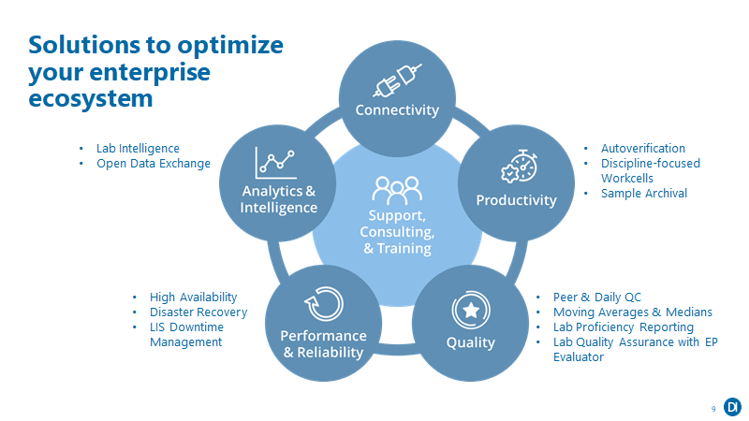
Notes:
Beyond our support of lab-wide and multi-lab integration connectivity, DI is able to empower clinical staff through improved efficiency and process optimization with flexible, powerful productivity solutions tailored to your lab's unique processes. These include Autoverification where it is possible to have a very high % of your results(95%+) automatically validated along with discipline focused workflow solutions that will streamline, enable standardization across instrumentation and sites. Additionally, Data Innovations Quality Suite provides real-time, proactive capabilities to catch, correct, manage and report on QC issues. Peer & Daily QC – Automate QC assessments, eliminating manual work and streamlining workflows. Instrument Manager offers a bi-directional interface with the industry’s leading peer QC products, including Bio-Rad URT®, Thermo LabLinkXL™, and others. Moving Averages - Proactively monitor and detect systematic changes between QC cycles, letting you catch and correct issues in real-time without increasing operational costs. CAP Lab Proficiency Reporting - Automatically and electronically transmit proficiency test results to proficiency testing providers. EP Evaluator for Lab QA - Create inspector-ready reports in minutes, and ease your regulatory compliance burden. Performance and Reliability - Always-on backup and restore solutions to ensure your lab operations continue seamlessly when outages occur. Analytics & Intelligence - Convert Instrument Manager data to operational insight for proactive line-of-sight into bottlenecks, efficiency issues, and your most important KPIs. Lab Intel - On-demand dashboards for at-a-glance laboratory operational insights. ODBC - Powerfully easy access to your Instrument Manager data for analysis and ad hoc reporting using any ODBC-compliant application, including Microsoft® Excel, Microsoft® Access, and Crystal Reports®.

Slide 10
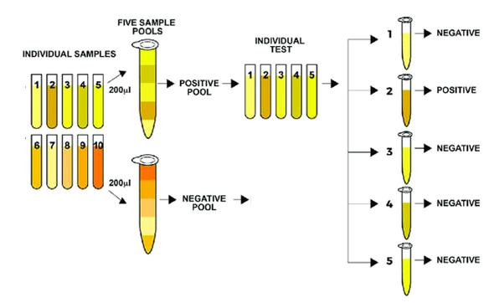
Pooling basics
Pools of five (5) specimens in each pool
Positive pool values are reflex tested to confirm positive specimen(s)
Negative pool values have the negative value copied to the pool constituents for reporting to the LIS/EMR
Report Specimen 6 through 10 as negative to the LIS/EMR
Note: This is an example. Pool size will vary based on SOP and Assay LOD. Coloration on samples and pools is for demonstrative purposes only.

Slide 11
Pooling considerations
Managing pool sizes
Not ‘one size fits all’
Sites are sourcing reagents from many vendors
Pooling management needs to be flexible while enforcing pool sizes based on assay LOD
Managing duplicates
Prevent conflicting results and wasted reagent by:
Understanding which specimens to pool and which have already been pooled
Preventing specimens that have already been pooled or resulted from being assigned to a new pool

Slide 12
Pooling considerations
Pre-screening and sorting of specimens to avoid over complicating the pooling workflow
Will specimens be pooled at the collection site?
Will specimens be pooled at the testing facility?
Ensuring suspect positive specimens are segregated from others to prevent high incidence of pool constituent confirmatory testing
Communicate to the LIS/EMR at the specimen level
Avoid costly and time-consuming validation of critical components by:
Only communicate to the LIS/EMR at the specimen (and not pool) level
Instrument orders and reflex testing
Instruments are not aware of pooled testing concept – just looking for a barcode and a test order so they can run

Slide 13
Pooling expertise
We provide a focus on interoperability – harmonizing pooling workflow across instruments, pooling devices, and LIS so that systems perform optimally whether running specimens as individual tests (no pooling) or as a pooled test.
Manage the relationship and correlation between pools and pool constituents
We propose a feature or utility to manage the status of specimens to assist pool operator indicating whether a specimen is awaiting pooling or if it has already been pooled to assist in loading the pooling device appropriately
Evaluate error scenarios upon pool receipt:
when a pooling run may introduce pool consistency errors such as different pool sizes, specimen types, or orders intended for different instrument/reagents
duplicated constituents either in the same pool run or across multiple runs, preventing the possibility of conflicting results
Pool Creation
Disclaimer: This is a proposal and not an assurance of existing product feature and it is not approved for sale in the United States.

Slide 14
Pooling Expertise
We provide a focus on interoperability – harmonizing pooling workflow across instruments, pooling devices, and LIS so that systems perform optimally whether running specimens as individual tests (no pooling) or as a pooled test.
Manage the relationship and correlation between pools and pool constituents
We propose a feature or utility to manage the status of specimens to assist pool operator indicating whether a specimen is awaiting pooling or if it has already been pooled to assist in loading the pooling device appropriately
Evaluate error scenarios upon pool receipt:
when a pooling run may introduce pool consistency errors such as different pool sizes, specimen types
duplicated constituents either in the same pool run or across multiple runs, preventing the possibility of conflicting results
Pool Creation
Upon receipt of pool data, we propose streamlining the process flow for both:
Positive results – automatically re-order (reflex) tests for each constituent of a pool for confirmation testing
Negative results – Assign the negative value to each constituent of a pool and report these results to the LIS/EMR to complete the pooling workflow
Testing Device
Disclaimer: This is a proposal and not an assurance of existing product feature and it is not approved for sale in the United States.

Slide 15
Pooling Expertise
We provide a focus on interoperability – harmonizing pooling workflow across instruments, pooling devices, and LIS so that systems perform optimally whether running specimens as individual tests (no pooling) or as a pooled test.
Send result records and receive orders that the LIS/EMR understands innately – patient data and not pool data – limiting any need for change in the LIS/EMR:
Data Innovations has software development experience that can manage the deconvolution process for both positive and negative pools, so that only patient information is exchanged with the LIS/EMR and not pool data
LIS
Manage the relationship and correlation between pools and pool constituents
We propose a feature or utility to manage the status of specimens to assist pool operator indicating whether a specimen is awaiting pooling or if it has already been pooled to assist in loading the pooling device appropriately
Evaluate error scenarios upon pool receipt:
when a pooling run may introduce pool consistency errors such as different pool sizes, specimen types
duplicated constituents either in the same pool run or across multiple runs, preventing the possibility of conflicting results
Pool Creation
Upon receipt of pool data, we propose streamlining the process flow for both:
Positive results – automatically re-order (reflex) tests for each constituent of a pool for confirmation testing
Negative results – Assign the negative value to each constituent of a pool and report these results to the LIS/EMR to complete the pooling workflow
Testing Device
Disclaimer: This is a proposal and not an assurance of existing product feature and it is not approved for sale in the United States.

Slide 16
The Path Forward
Data Innovations is actively exploring creating a pooling solution featuring Instrument Manager
Due to national reagent shortage and increasing need for mass screening for COVID, we are looking to rapidly deploy a solution to the market
The solution will intentionally focus on compatibility with existing instrument and LIS/EMR workflows to minimize customer validation and possible lab downtime
Disclaimer: This is a proposal and not an assurance of existing product feature and it is not approved for sale in the United States.

Slide 17
A call to action
DI is actively looking for facilities to partner with us for:
Evaluation of pool workflow requirements
Potential beta testing participants for a proposed pooling feature in Instrument Manager
If interested, please reach out to your sales representative or contact:
sales@datainnovations.com for more details
Disclaimer: This is a proposal and not an assurance of existing product feature and it is not approved for sale in the United States.

Slide 18
EE COVID-19 Use Case Overview
Notes:
Thank you Colleen, Hi Everyone, I’m Cathy, just a little background about me I am a Medical Technologist by education. I worked 16 years in the hospital lab as a Tech and I have worked in the IVD industry for at least that many years. Today we are going through a few testing scenarios in which EP Evaluator can support you and point to the validation testing needed if you are trying to release a Laboratory Developed Test such as a Covid-19 assay.

Slide 19
Lab Quality Assurance with EP Evaluator
Accelerate the Performance Verification(PV) studies
Improve the accuracy of instrument PV studies
Industry leader in streamlining performance validation
Compliant, inspector-ready reports
Notes:
I want to show you how EP Evaluator can be a powerful lab partner that can simplify data analysis, it’s going to
help you build traceable documentation to show to inspectors and save you time. If you are anything
like me, when the ER is calling for results, or your main analyzer or automation line is down and the
workload is got you slammed sometimes housekeeping can take a back seat. Not that your not taking care
of business but crisis management has a way of pushing its way to the front of the line. EP Evaluator can
really make routine Quality analysis and documentation much faster and easier.

Slide 20
Instrument and method validation at scale
Perform calculations
for 100+ experiments simultaneously
Simplify instrument-to-instrument comparison
Conduct multiple instrument comparisons
Validate according to your lab’s specific ranges
Notes:
EE can calculate and print all the saved experiments within a designated module at one time.
With your saved data you can customize which instruments you want to compare without rerunning the experiments.
You can run assays in multi-analyte panels versus individual runs
And you can Establish or Verify reference ranges for your specific patient population.

Slide 21
Instant, easy-to-read, inspector-ready reports
Rapid
High-throughput
Easy-to-read, printable reports
Regulation compliant with CLIA, CAP, Joint Commission, and COFRAC requirements
Notes:
Now, Here is an example of a report. I want to show you it’s clean and It’s easy to read and these reports
are readily accepted by inspectors.

Slide 22
Current Environment and how EP Evaluator can help
Comparing performance between Laboratory Developed Assays and Manufacturer provided assays on one or more platforms
Onboarding a new assay on an existing platform or go-live on new instrument
Running periodic Performance Verification studies to meet CLIA or The CAP requirements
Trying to create laboratory developed assays under the FDA-Emergency Use Authorization (EUA)
Notes:
In this crazy environment we are working in I can imagine a few scenarios or ‘Use Cases’ where EP Evaluator can come in handy.
There may be Labs that are trying to compare performance between a Laboratory Developed Assay and market released manufacturer assays on one or more platforms.
There will be Labs that need to add a new assay to their testing menu on an existing instrument or trying to go live on new instrument
Labs are going to need to run periodic Performance Verification studies to meet CLIA or Laboratory Accreditation requirements.
4. And there are some Labs that are going to do their own Research and Development and need to validate their Laboratory developed Test under the FDA-Emergency Use Authorization (EUA)

Slide 23
Use Cases: Comparing LDTs vs Comm Tests, Onboarding New Assays, Running PVs
Statistical Modules | EP Module | Short Description
Precision | SP | Simple Precision experiments evaluate the degree to which repeated measurements of the same specimen (or specimens) show the same result. To do this statistically it calculates mean, SD, and CV.
Linearity | Linearity and Cal Verification | Verifies linearity, accuracy, reportable range, precision and the probability of passing proficiency testing (PT), using a single set of at least 3 standards with defined or known concentrations that span the claimed Reportable Range.
Method Comparison | Alternate (Quantitative) | Basic correlation
 | QMC | Concordance-Compares results from qualitative or semi-quantitative methods.
Notes:
In my years working in the laboratory or installing new chemistry instruments in other labs, the protocols I
most often used were the Simple Precision, the Linearity & Cal Verification and Correlation studies which I
usually ran the alternate Quantitative Protocol for Correlation. I also want to point out that the QMC
module will give you a concordance for your Semi Quant and Qualitative Assays such as Drugs of Abuse or
possibly a Covid-19 or Point Of Care test.

Slide 24
Use Case: Creating a LDT
CLSI /EP Guideline | EP Module | Short Description
EP 5 | CP - Complex Precision | CP calculates within run, between run, between day, and total precision. The CLSI EP5 protocol is a subset of this statistical module.
EP 6 | EP6 - Linearity | This module verifies linearity.
EP 7 | EP7-Interference | Interference estimates the maximum level of an interferent that can be present without causing a clinically significant change in the analyte measurement.
EP 9 | EP9 A2 - Method Comparison | EP9A2 (based on CLSI EP09-A2) EP9A2 is a statistically rigorous method comparison protocol that requires a minimum of 39 specimens assayed in duplicate.
 | EP9 A23 - Method Comparison | EP9A3 (based on CLSI EP09-A3) The EP9A3 module is a new advanced method comparison module designed for use with the CLSI protocol document.
EP10 | CLSI EP10 Preliminary Evaluation | This module is a fast, simple, protocol to do a preliminary evaluation of a new method for linearity, recovery, precision, carryover, and drift.
(12) | QMC | Compares results from qualitative or semi-quantitative methods.
(17) | LOQ | Sensitivity determines the lowest concentration that can be measured with acceptable precision.
(28) | VRI | Verification of Reference Interval (VRI) uses a minimum of twenty values to verify a previously established reference interval.
 | ERI/ROC | (ERI) establishes a new reference interval
(21) | 6SIG | provides guidelines for setting an Allowable Total Error goal.
(25) | STB EP25 | evaluates rate of measurand drift.
(15 ) | SP | Simple Precision experiments evaluate the degree to which repeated measurements of the same specimen (or specimens) show the same result. To do this statistically it calculates mean, SD, and CV.
Notes:
If however you are involved with trying to validate a Laboratory Developed assay such as a Covid-19 test, you will need to perform additional Validation studies to meet the testing requirements for the FDA – Emergency Use Authorization.
I want you to be aware that EP Evaluator has these test protocols available for this use case too and they follow the CLSI guidelines.
Here is a list of CLSI protocols and their corresponding EP Evaluator modules.
Note that for this scenario you will be running both the Simple and the EP5 protocol for precision.
You will use the EP 6 for Linearity rather than the Calibration Verification and Linearity protocol
And you will use EP9 for Correlation.

Slide 25
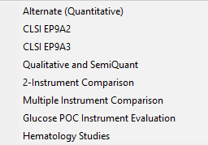
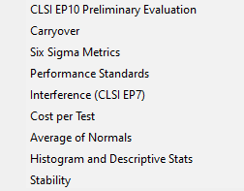
Notes:
For those of you that may not be familiar with the Evaluator I wanted to give you a brief overview. I won’t go through everything but I want to show you how to navigate the basics.
Precision, you will use the Simple in most cases, EP 5 if you are testing under the EUA
Accuracy, you will use the Linearity and Calibration Verification in Most Cases and EP 6 for the EUA
For Method Comparison you will most likely use the Alt. Quantitative and EP 9 for the EUA (note the Qual/Semi Quant is in this section)
Sensitivity and Ref Intervals are next
under Other you will find Carryover, Stability and Interference studies which you will most likely need for and a laboratory developed test.

Slide 26
Ease-of-Use
Data Entry Type | Considerations | EP Evaluator Product Type | Grade
Manual entry | Slow speed of entry, typos, one analyte at a time | All | Good
Rapid keyboard entry from instrument printouts using a panel defined worksheet | RRE | Standard | Good
Copy-and-paste from Microsoft Excel | RRE Wizard for multiple analytes, multiple instruments – but still need to put the data into the worksheet | Standard | Better
Instrument data capture – RRE Wizard | Cable hookup, or instrument generated file. Drivers for IVD manufacturers only | Data Capture | Better
Data capture from Instrument Manager | RRE – Simple data query for thousands of results | Data Capture | Best
Notes:
There are a number of ways to enter data into EP Evaluator. If you don’t have Instrument Manager then You can choose manual entry or you can download data from an instrument to a USB, transfer that to Excel then bring it into EE using Rapid Results entry feature.
If you Do have Instrument Manager then the data from your studies reside on the server with Instrument Manager and can be accessed through the Open Database Connectivity feature available in EP Evaluator Pro. This would allow Techs in various department and locations to access data from their workstations.
Minimum Requirements for the OBDC option
EP Evaluator Pro
For the IM you need at least have version 8.14
You need a Specimen Management licensed
And the OBDC driver licensed

Slide 27
Resources
https://www.datainnovations.com/ep-evaluator-resources
https://www.fda.gov/medical-devices/emergency-situations-medical-devices/emergency-use-authorizations
https://clsi.org/standards-development/helpful-documents-for-covid-19-testing/
https://www.cap.org/news/2020/latest-on-the-novel-coronavirus-covid-19
https://www.cdc.gov/clia/index.html
Notes:
Now, That wraps up things for me. I want to leave you guys with some resources that will guide you through using EP Evaluator. You may want to check out these other sites if you are in the position of validating a Lab Developed Assay under the Emergency Use Authorization. I want to Thank everyone for your time and Colleen, I’m going to hand this back to you.

Slide 28
Questions?

Slide 29
Upcoming Virtual User Groups
Lab Intelligence
September 15th at 10AM PT/1PM ET
Autoverification Rules 101
September 22nd at 10AM PT/1PM ET
High Availability & Disaster Recovery
September 29th at 10AM PT/ 1PM ET

